Slide 1
Digital product design
Lecture 3: EVC & Market Analysis
Alex Moehring
*Based on slides provided by Catherine Tucker

Slide 2
Outline
Ideation Review
Economic Value to the Customer
Competitive Analysis
EVC Calculations for Projects

Slide 3
Economic value to the customer

Slide 4
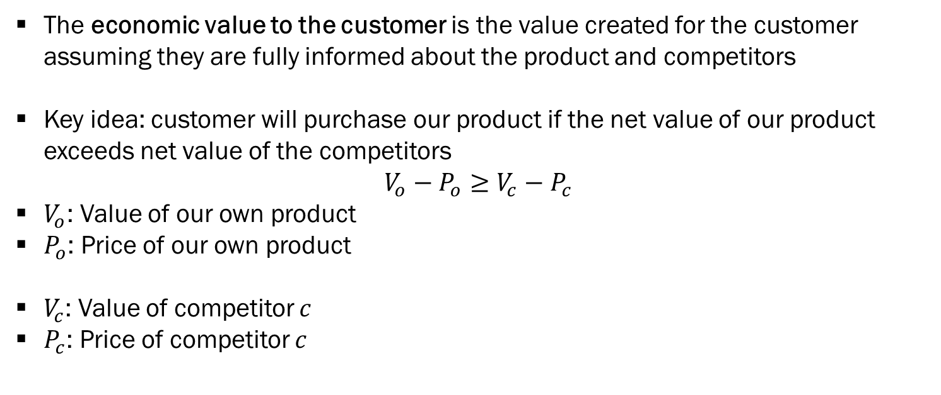
Economic Value to the Customer
The economic value to the customer is the value created for the customer assuming they are fully informed about the product and competitors
Key idea: customer will purchase our product if the net value of our product exceeds net value of the competitors
$$V_{o}−P_{o}≥V_{c}−P_{c}$$
$V_{o}$: Value of our own product
$P_{o}$: Price of our own product
$V_{c}$: Value of competitor $c$
$P_{c}$: Price of competitor $c$

Slide 5

Economic Value to the Customer, Part 2
$$V_{o}−P_{o}≥V_{c}−P_{c}$$

Slide 6
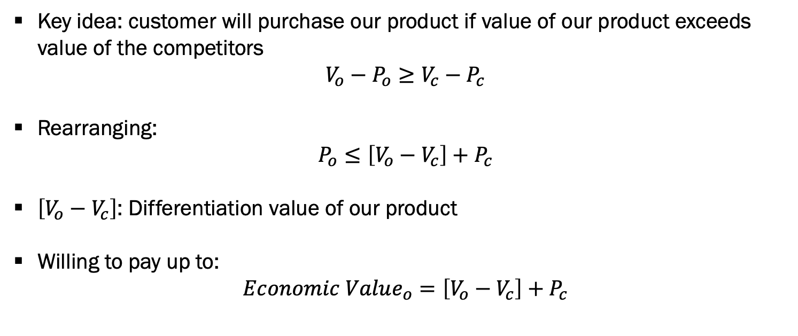
Economic Value to the Customer, Part 3
Key idea: customer will purchase our product if value of our product exceeds value of the competitors
$$V_{o}−P_{o}≥V_{c}−P_{c}$$
Rearranging:
$$P_{o}≤\left[V_{o}−V_{c}\right]+P_{c}$$
$\left[V_{o}−V_{c}\right]$: Differentiation value of our product
Willing to pay up to:
$$Economic Value_{o}=\left[V_{o}−V_{c}\right]+P_{c}$$

Slide 7
Economic Value to the Customer, Part 4
Useful way to reason about the value our product creates for customers
How does this solve a problem better than competitor?
How does our competitors price impact the value of our offering?
EVC summarizes the value created by our offering
Corresponds to a theoretical upper bound of how much customer will pay

Slide 8

A Concrete Example – Hydroponic Tulips
New container named TulipBowl allows tulip farmers to grow tulips hydroponically
Use water rather than soil to grow bulbs
Current tulip growing containers retail at $10 each
New container:
Increases yield (reduces waste)
Uses cheaper mineral nutrients vs pesticides

Slide 9
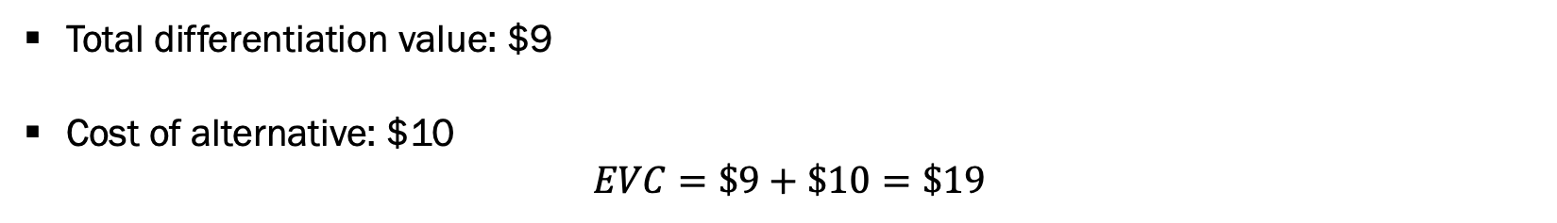
A Concrete Example – Hydroponic Tulips, Part 2
Feature | Existing Container | New Container | Diff Value
Pesticides | $2.50 | 0 | $2.50
Mineral Solution | 0 | $1.50 | -$1.50
Reduces Disease | $80 if happens Pr(Disease)=0.1 | 0 | $8
Total Diff Value |  |  | $9
Total differentiation value: $9
Cost of alternative: $10
$$EVC=\$9+\$10=\$19$$

Slide 10
Step-by-Step Guide
Identify the end benefit
Identify the closest competitor
Identify closest competitor’s price
Measure differentiation values
Calculate EVC
Repeat for various configurations and customer segments

Slide 11
1. Identify the End Benefit
Hopefully we have a clear value proposition for our new product or feature
Ideation process is customer and solution oriented
Should have a clear thesis on how our product delivers value to end user

Slide 12
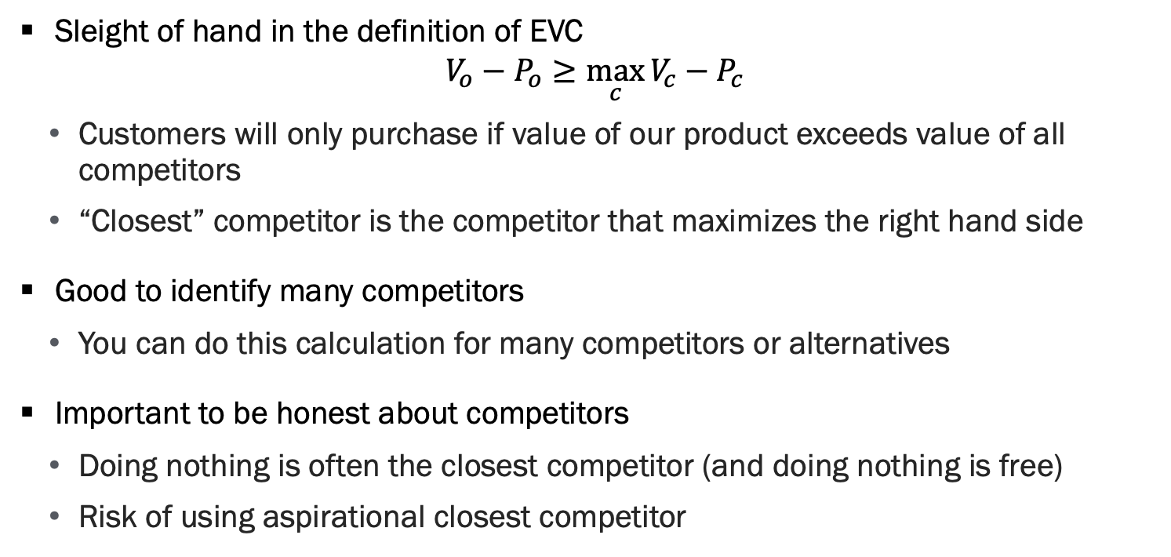
2. Identify the Competitors
Sleight of hand in the definition of EVC
$$V_{o}−P_{o}≥\max_{c}{V_{c}−P_{c}}$$
Customers will only purchase if value of our product exceeds value of all competitors
“Closest” competitor is the competitor that maximizes the right hand side
Good to identify many competitors
You can do this calculation for many competitors or alternatives
Important to be honest about competitors
Doing nothing is often the closest competitor (and doing nothing is free)
Risk of using aspirational closest competitor

Slide 13


2. Identify the Competitors
Notes:
Zoom’s closest competitor is skype or telephone for most customers, not the $80k video-conferencing room

Slide 14

3. Identify the Competitor Prices
Notes:
EVC can look overly optimistic if you use competitor’s sticker price in industries where discounts are rampant
Very important in enterprise software sales, pricing is super opaques.

Slide 15
4. Measure Differentiation Values
If product is developed, can do some field tests to assess value (e.g. A/B test)
Use the results of survey analysis (e.g. conjoint feature values)
This gives us a dollar value for various features
Make sure survey respondents are representative of customer segment!
Also easy to do when your product saves the customer costs
Example: Automation software, medical devices, reducing waste

Slide 16

4. Measure Differentiation Values

Slide 17
Calculate EVC for Various Segments
Once we have differentiation value and competitors price, easy to calculate EVC
EVC can vary widely by customer segment
Differentiation likely differs by segment
Closest competitor can differ for various segments

Slide 18
Uses of EVC
EVC helps us understand the potential of a market
Can be done with very little data
As you collect more data, can refine estimates of differentiation value
Feature prioritization
What features differentiate our product from competitors?
Also frequently used in pricing
Gives a sense of the maximum you can charge
Best practice to discount off of EVC
Gives sales an answer to the question “How can you charge so much?!?”

Slide 19
Competitive analysis and Game theory

Slide 20
EVC Calculations Have a Strong Assumption
Competitors respond to changes to the competitive landscape
How can competitors respond?
Reduce prices
Imitate product
Invest in new features
…
Game theory provides the tools to study strategic interactions between players
Players here are different firms (including us!)

Slide 21
Game Theory Key Ideas
Individuals acting strategically in their best interests taking into account other player’s strategies
If we change the game (i.e. market) by introducing a new feature / product, how will competitors respond?
Nash Equilibrium: No player can profit from a deviation given the strategies of others
Game theory is an incredibly rich field
Not possible to cover in a 6 week class, let alone half a class!
Without formal modeling, we can reason about equilibrium concepts
i.e. if we undercut our competitors’ price, how will they respond?

Slide 22
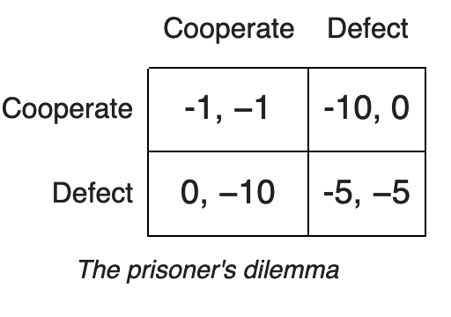
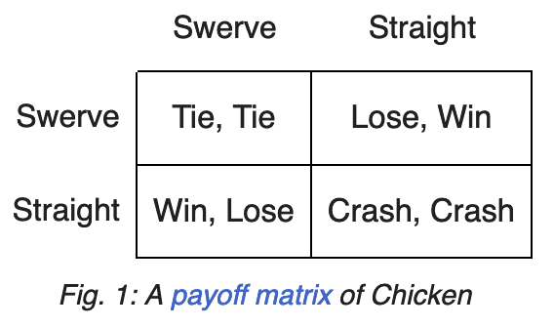
Finding Equilibria
General idea: Calculate best-response functions of each player
This is function returns the best move you can make in response to the other players’ strategies
Equilibrium is when every player is best-responding to everyone else

Slide 23
Game Theory to Understand Competitive Response
If we enter the market with a new product or feature, how will competitor respond?
We can reason about their best-response to our new product / feature
Competitors notice a negative EVC of their product
Best response likely includes a combination of:
Price decreases to make competitor’s EVC calculations look more favorable
Imitation / investment to reduce the disparity in differentiation value

Slide 24
Game Theory to Understand Competitive Response, Part 2
Important question at design phase: Is competitive advantage sustainable?
How will our EVC calculations change after the competitor responds by cutting prices or changing their product offering?
Two scenarios:
Large differentiation value: prevent competition from copying innovation?
Patents, proprietary technology, proprietary data, network effects, switching costs, …
Small differentiation value:
Price war has at most two winners: Customer and low-cost producer

Slide 25
Practice EVC

Slide 26
Practice EVC
Let’s do an EVC analysis for the product you are using in your project
Gather as a team, work through the various steps for the product

Slide 27
Step-by-Step Guide
Identify the end benefit
Identify the closest competitor
Identify closest competitor’s price
Measure differentiation values
Calculate EVC
Repeat for various configurations and customer segments

Slide 28
Summary

Slide 29
Recap
EVC helps us understand the potential of a market
Theoretical maximum willingness to pay for our product
Feature prioritization
What features differentiate our product from competitors?
Frequently used in pricing
Important to reason about how competitors will respond to our offering

Slide 30
Project
Key Dates
10/31: Team formed and product selected (email me your team)
Also self-enroll for groups on Brightspace!
11/6: Midpoint check-ins
12/9-12/11: Final project presentations + final report due

